Slide 1
Network Intrusion Detection Combined Hybrid Sampling With Machine Learning
Md. Ismail Hossain
Md. Sadiqul Amin

Slide 2
Index
1. Introduction
2. Existing Work
3. Our Proposal
4. Application
5. Data Set
6. Methodology
Plan A
Plan B
7. Conclusion
8. Reference

Slide 3
Technical Terms
NIDS
Hybrid Sampling

Slide 4
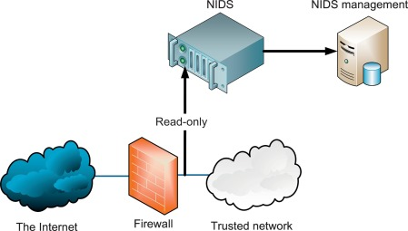
Introduction
NIDS
A network-based intrusion detection system (NIDS) detects malicious traffic on a network. NIDS usually require promiscuous network access in order to analyze all traffic, including all unicast traffic. NIDS are passive devices that do not interfere with the traffic they monitor; Fig. shows a typical NIDS architecture. The NIDS sniffs the internal interface of the firewall in read-only mode and sends alerts to a NIDS Management server.

Slide 5
Our Proposal
In our proposed method we will use hybrid sampling on our data set to make our dataset balanced then we will use different machine learning models and compare them. Our goal is to improve the accuracy and time complexity.
Data set
Hybrid Sampling
Machine Learning Model

Slide 6
Our Proposal
Hybrid Sampling
Data set
Majority
Minority
Under sampling
Over sampling
Balanced Dataset

Slide 7
Our Proposal
Machine Learning Algorithm:
SVM
Decision Tree

Slide 8
Data set
NSL-KDD
Link:
https://github.com/InitRoot/UNSW_NB15
https://www.kaggle.com/hassan06/nslkdd

Slide 9
Methodology
First we will perform hybrid sampling in our data set to make our data set balanced.
Then we will train different Machine learning model.
Test our models.
We observe the performance of these models.
Select the most accurate model.

Slide 10
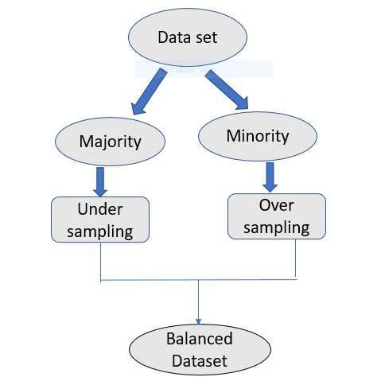
Methodology
Plan A
Model Training
Training data
ML model
SVM
Test Data
Classification result

Slide 11
Methodology
Plan B
Model Training
Training data
ML model
Decision Tree
Test Data
Classification result

Slide 12
Methodology
Plan C
Model Training
Training data
ML model
C5
Test Data
Classification result

Slide 13
Conclusion
After testing we will compare our models and among them chose the best one based on less time complexity and best performance.

Slide 14
Reference
Data:
https://github.com/InitRoot/UNSW_NB15
https://www.kaggle.com/hassan06/nslkdd
Paper:
D. Papamartzivanos, F. G. Marmol, and G. Kambourakis, ``Introducing deep learning self-adaptive misuse network intrusion detection systems,‘’ IEEE Access, vol. 7, pp. 1354613560, 2019.
S. M. Kasongo and Y. Sun, ``A deep learning method with lter based feature engineering for wireless intrusion detection system,'' IEEE Access, vol. 7, pp. 3859738607, 2019.
Network Intrusion Detection Combined Hybrid Sampling With Deep Hierarchical Network KAIYUAN JIANG , WENYA WANG , AILI WANG , AND HAIBIN WU
4. An Anomaly Intrusion Detection System Using C5 Decision Tree Classifier
Ansam Khraisat(B), Iqbal Gondal, and Peter Vamplew

